Slide 1
Perform data engineering on Azure

Slide 2


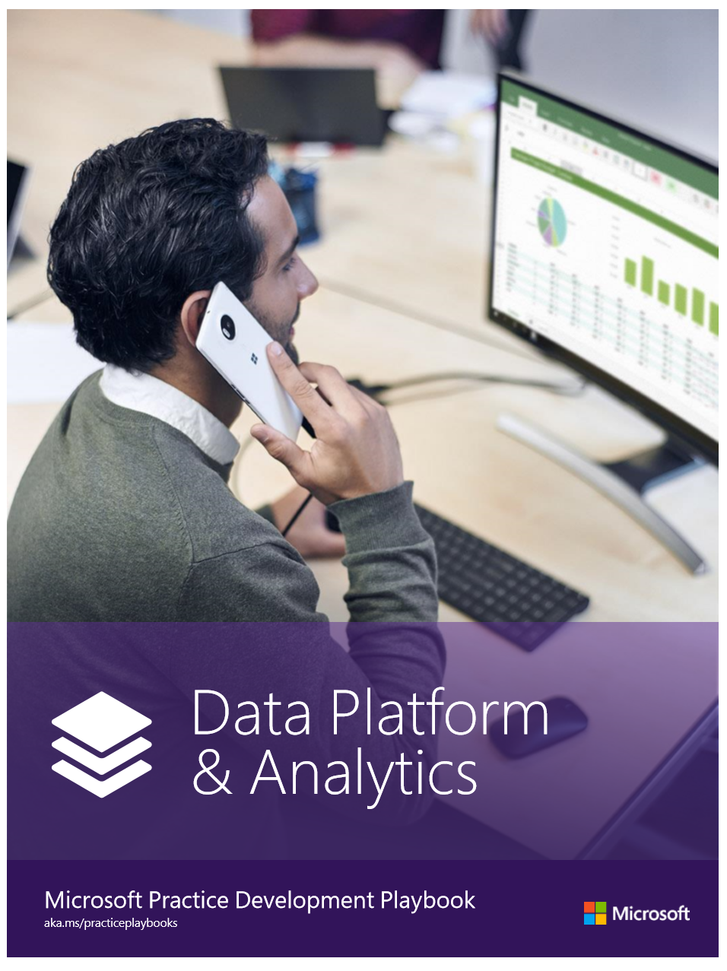


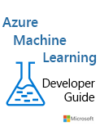
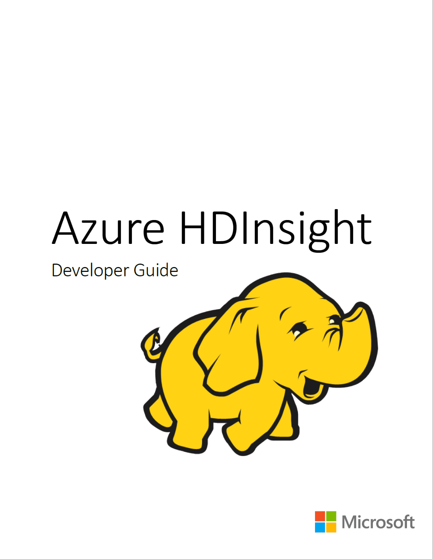
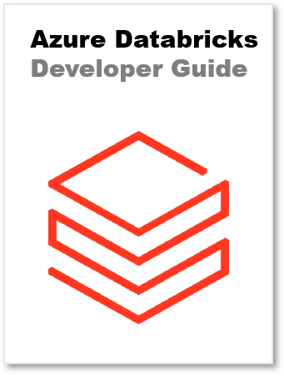
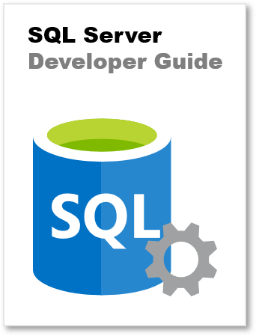


Joel Hulen
Senior Data Engineer / GM Training Practice
29+ years in the industry
Author/co-author of several books on Azure
joel@solliance.net
https://github.com/joelhulen
https://bit.ly/joelhulen

Slide 3





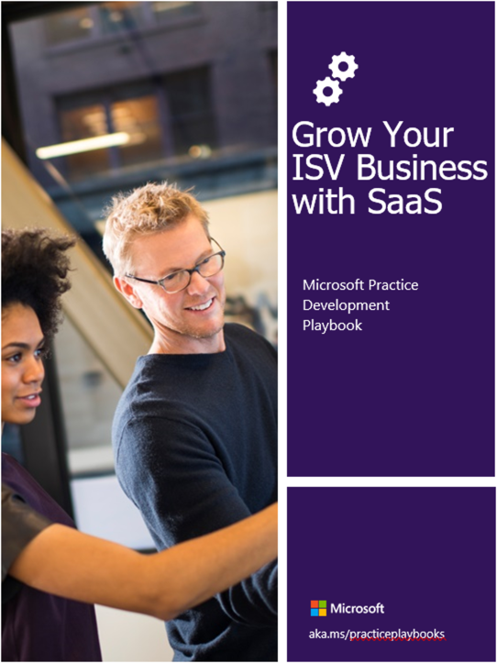


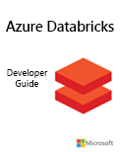
Kyle Bunting
Data Architect & Engineer
23+ years in IT
MBA, Krannert School of Management, Purdue University
Author / contributor of multiple books and whitepapers
kyle@solliance.net
https://github.com/kylebunting
https://www.linkedin.com/in/kylebunting

Slide 4

Chris Testa-O’Neill
Principal PM: Data and AI @ Microsoft
20+ years in Data and Analytics
6 years working at Microsoft
3 years in AI Engineering
3 years in World Wide Learning
20 years as Microsoft Certified Trainer
Chris.testaoneill@microsoft.com
https://github.com/ctesta-oneillmsft
https://www.linkedin.com/in/ctestaoneill

Slide 5




CLOUD IS AT THE CENTER OF EVERYTHING WE DO.
ELIMINATE RISK, CALL IN THE SPECIAL FORCES.
THOUGHT LEADERS
Providing lone wolf, technical experts a pack to run with since 1998
COMPREHENSIVE TEAMS
Deliver a team of solution experts to our customers, focusing on innovation
GLOBAL EXPERIENCE
Our team of 280+ Experts average 20+ years of experience and span 17 countries
PRACTICES
DATA & AI
SECURITY
INFRASTRUCTURE & DEVOPS
ADVANCED COMPUTING
MICROSERVICES
APPLICATIONS
TRAINING
MEDIA
Our Experts fan out their expertise in eight practices.
Our Implementation Experts are also skilled trainers because our philosophy is to enable our customers to operate our solutions after we leave.
24 Microsoft MVPs
7 Microsoft Regional Directors
1 AWS Hero
2 Google Developer Experts

Slide 6
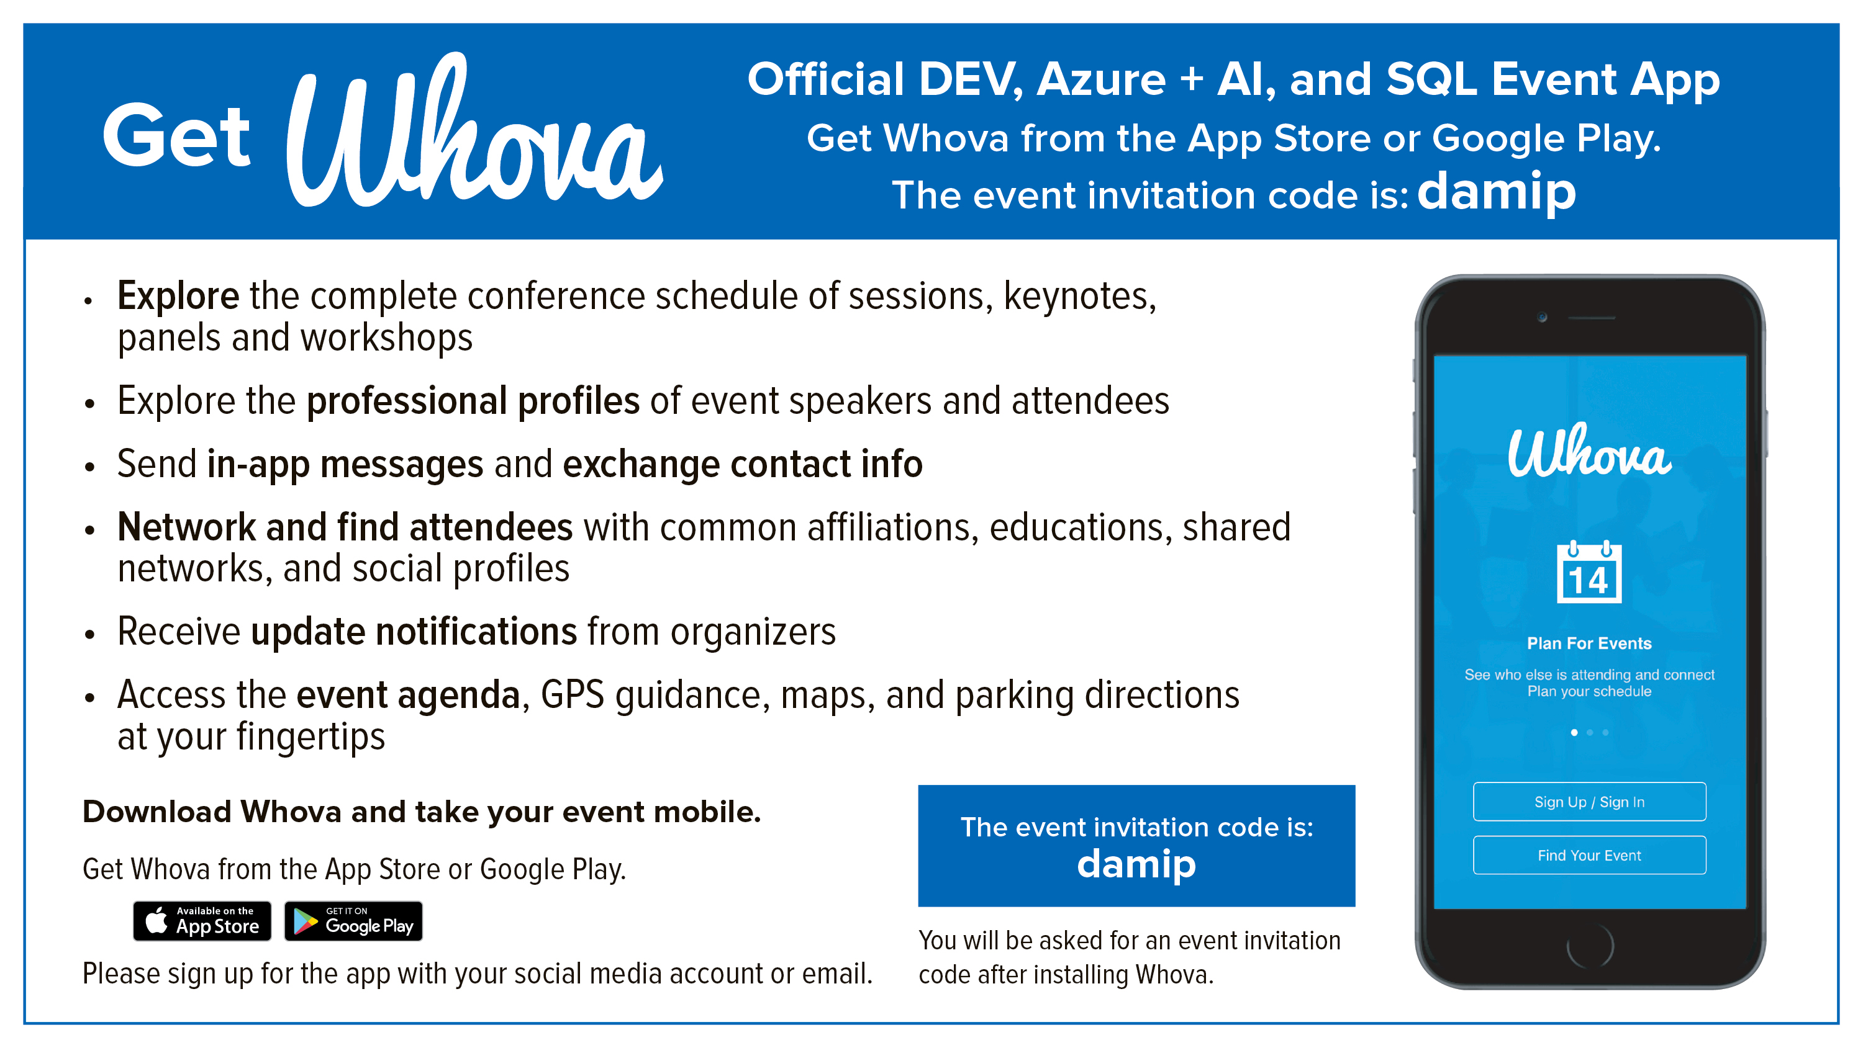

Slide 7
Register your lab environment
Navigate to https://portal.cloudlabs.ai/
Sign in with your Work or School account, Microsoft Account, LinkedIn, or Google
Navigate to the Redeem Voucher section in CloudLabs portal
Enter Voucher Code
Click on Redeem option
Once voucher is redeemed, navigate to ‘Courses’ tab under the ‘My Learning’ section and start learning by clicking to Get Started/ Start option

Slide 8
Workshop agenda
Day 1
Kick-off presentation
Explore compute and storage options for data engineering workloads
Run interactive queries using Azure Synapse Analytics serverless SQL pools
Lunch (12:20pm – 1:20pm)
Data exploration and transformation in Azure Databricks
Explore, transform, and load data into the Data Warehouse using Apache Spark
Day 2
Ingest and load data into the data warehouse
Integrate data from Notebooks with Azure Data Factory or Azure Synapse Pipelines
Support Hybrid Transactional Analytical Processing (HTAP) with Azure Synapse Link
Lunch (12:00pm – 1pm)
Real-time stream processing with Stream Analytics

Slide 9
So, what is an Azure data engineer?
1

Slide 10
What is an Azure data engineer?
Herds and tames data
Data explorer and investigator
Builds and maintains data pipelines
Provides janitorial services to clean, store, and enhance data
Pit crew
Notes:
The Azure Data Engineer integrates, transforms, and consolidates data from various structured and unstructured data systems into a structure suitable for building analytics solutions.
They explore data to investigate specific data questions posed by stakeholders.
The Data Engineer builds and maintains secure and compliant data processing pipelines by using different tools and techniques.
This role uses various Azure data services and languages to store and produce cleansed and enhanced datasets for analysis.
A Data Engineer ensures that data pipelines and data stores are high-performing, efficient, organized, and reliable given a set of business requirements and constraints. They deal with unanticipated issues swiftly and minimizes data loss. They also design, implement, monitor, and optimize data platforms to meet the needs of the data pipelines.
The Data Engineer must have strong knowledge of data processing languages using SQL, Python, or Scala. Understand parallel processing, and data architecture patterns.

Slide 11
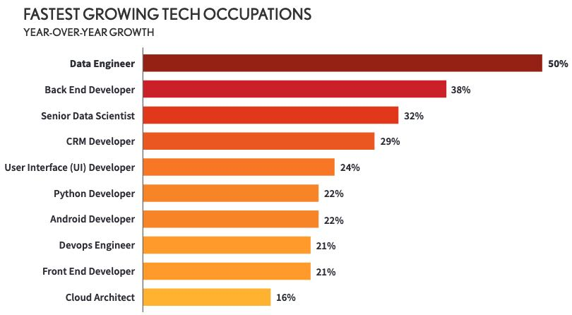
Data engineers are in high demand!
Data engineering job listings - Source: Dice tech job report 2020
Notes:
As we’ll see in the next couple of slides, data engineers are critical for companies solving many data-related problems.

Slide 12
And… what problems are we trying to solve?
2

Slide 13
The modern data problem
1
Volume What most people think of… the sheer amount of data. Worldwide, this grows exponentially. 90% of today’s data has been created in the past 2 years!
2
Velocity The speed of data coming in, and the speed in which you need to process it. In addition, we need elasticity of our data systems to cope with variable loads.
3
Variety Data comes from so many sources these days, from structured relational data sets and financial transactions to unstructured data such as chat and SMS messages, IoT devices, images, logs, MRIs, etc. 90% generated data is unstructured.

Slide 14
Velocity: the 3 latencies
1
Batch Queries or programs that take tens of minutes, hours, or days to complete. Could include initial data munging, complete ETL pipeline, preparation for downstream analytics.
2
Interactive query Querying batch data at “human” interactive speeds, which with the current generation of technologies means results are ready in time frames measured in seconds to minutes.
3
Real-time / near real-time Processing of a typically infinite stream of input data (stream), whose time until results ready is short—measured in milliseconds or seconds in the longest of cases.
You will typically use these three velocities together. Batch is always at the periphery of real-time stream ingestion, because you oftentimes want to do a deeper analysis of the ingested data.
Notes:
Batch queries or programs that take tens of minutes, hours, or even days to complete. Initial data munging efforts to a more complete ETL pipeline, to preparing data for ultimate consumption over very large data sets or where the computation takes significant time. In other words, batch processing is a step in your lambda architecture processing pipeline—one that either leads to further interactive exploration (downstream analytics), provides the modeling-ready data for machine learning, or lands the data in a data store optimized for analytics and visualization.
Interactive query capabilities by pruning large data sets during query processing to achieve faster query execution. Indexes, partitioning, predicate pushdown (where clauses) toward the storage layer, not after you received all the data

Slide 15
How do we cope with the data problem?
Velocity
Rapid Growth
Variety
Processing & Insights
Notes:
On top of the challenges I already mentioned, companies oftentimes face complexities caused by needing to integrate many data sources. As companies continue to find more ways to benefit from data, like understanding the current state of their business, predicting the future, modeling their customers, preventing threats, and creating new products, they tend to pull in more data sources and try to make sense of it all in a single place.

Slide 16
Designing a modern data warehouse
3

Slide 17
Intelligent Data Platform Architecture Pattern
INGEST
PREPARE
PROCESS
ENRICH
SERVE
STORE
DISCOVER & GOVERN
CORE PLATFORM (IDENTITY, SECURITY, MONITORING, OPERATIONS)
Notes:
We are recommending the data platform be built following an Intelligent Data Platform architecture pattern. This architecture pattern delivers a solution that is flexible, scalable, and extensible to allow Brannon Steel to easily invest in modernizing their data platform while also providing a flexible platform to enable future innovation and growth, such as the incorporation of AI. Following industry best practice guidance, the architecture describes how and where data should be stored, governed, and secured.
The diagram we are viewing on this slide is a simplified overview of the pattern.
The top line describes how data is extracted from source systems, processed, and served up to various analytical and reporting tools. This is where many of the manual processes involved in data extraction and processing in the current process can be automated.
Ingest: Data ingestion describes the processes involved in extracting data from source systems (e.g., Dymanics NAV/Business Central) and landing copies of those data in the landing zone container in the data lake. This is where automated pipelines will be used to extract raw data based on defined schedules driven by data freshness requirements and availability.
Prepare: The preparation step of the process involves transforming raw data from its native format into the standard formats and folder structures required for downstream processing.
Should prepare data to be imported into Business Central/NAV
Automation into BC should be in scope. But not NAV.
EDI is only a couple customers.
Process: Data processing includes tasks to standardize, deduplicate, cleanse, and transform data into the shape required for analytics.
Enrich: (Future state) Enrichment involves leveraging additional datasets, external APIs, and AI to derive novel insights from data and augment the data available for business-critical decisions.
Serve: The serving layer provides data to analytics and reporting tools.
Data storage refers to the enterprise data lake that provides a common data store across the platform.
Governance and discovery ensure users are able to easily find and analyze data (future state).
The core platform refers to Microsoft Azure, which provides the base functionality essential to any enterprise data solution. The platform should be relied upon to deliver capabilities like identity management, security, monitoring, and operations.

Slide 18




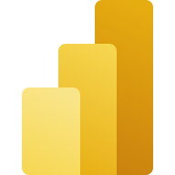

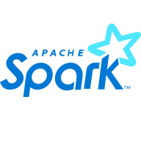



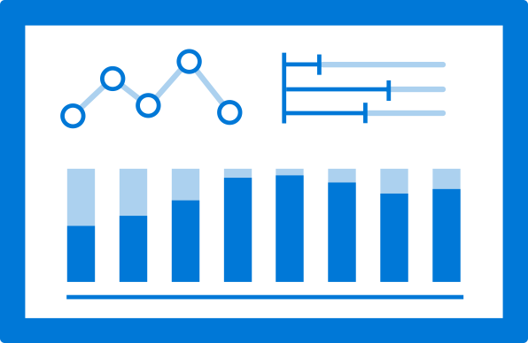










Data Platform Architecture
ENRICH
DATA SOURCES
STORE
PREPARE & PROCESS
SERVE
BUSINESS USERS
INGEST
Azure AI
Services
Azure ML
Dynamics
NAV 2009 R2
Power BI
Spark Pools
Applications
Data Factory
Pipelines
ADLS Gen2
Business
Central
Serverless SQL
Pools
Analytics
Pipelines
DISCOVER & GOVERN
Microsoft Purview
CORE PLATFORM
Microsoft Entra ID
Cost Management
Key Vault
Azure Monitor
Security Center
Azure Policy
GitHub / Azure DevOps
Notes:
Intelligent Data Platform architecture description and arch diagram.

Slide 19
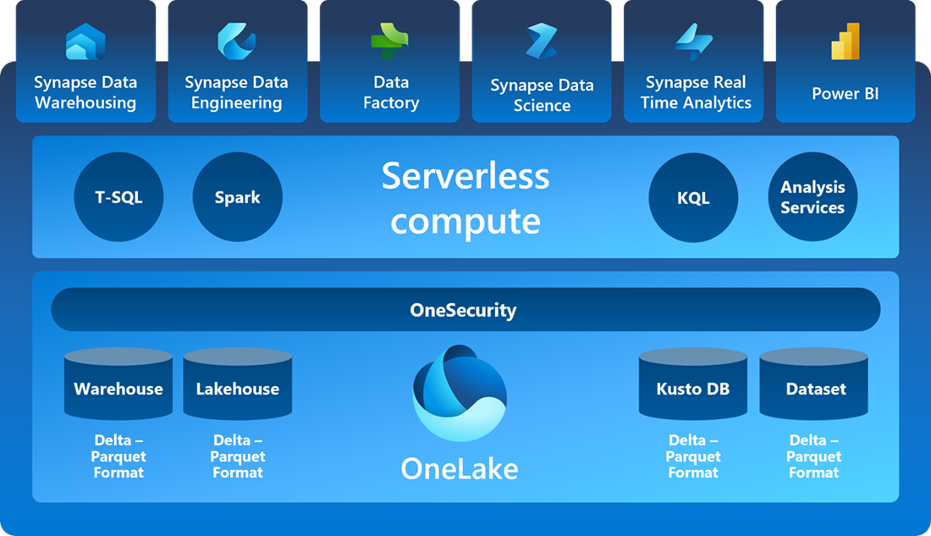
Notes:
Microsoft recently announced Microsoft Fabric, which is their latest innovation in modern data platforms and the evolution of Azure Synapse Analytics. Microsoft Fabric is an end-to-end analytics solution with full-service capabilities including data movement, data lakes, data engineering, data integration, data science, real-time analytics, and business intelligence—all backed by a shared platform providing robust data security, governance, and compliance.
In Fabric, many of the tools and technologies needed to build a comprehensive data platform are integrated into a single software-as-a-service (SaaS) product that addresses everything from extracting raw data from source systems to processing and enriching those data to providing a serving layer accessible to reporting and analytics tools used by data consumers.
Mention that Fabric has recently gone GA but that not all features in there yet.

Slide 20
The modern data warehouse
INGEST
PREPARE
TRANSFORM & ENRICH
SERVE
VISUALIZE
STORE
Notes:
Speak briefly about the flow of data in a Modern Data Warehouse, highlighting each of the steps/components.
Store: We need a storage layer capable of handling not only structured data, but also our semi-structured and unstructured data.
Ingest: The Modern Data Warehouse relies on the ability to ingest data from disparate sources and write those data to the underlying data store.
Prepare: The preparation step is where data engineers explore the data, checking data quality, content, and other features to prepare it for use in analytical workloads.
Transform & Enrich: In this step, we are standardizing features of the datasets and possibly combining with data from other systems to enrich the data. We also will be writing out to other folders in the data lake and getting the data ready to be sent to a serving layer.
Serve: At this step, we are writing data out to tables (in the data warehouse, for example) so that it can be accessed and used by analytics tools, such as Power BI.
Visualize: This is where we actually make use of the insights derived from our data, displaying dashboards and other visualizations that aid business decision-makers in understanding the data and insights it can provide.
Note: The next slide will dive into how Synapse addresses each of these steps, so no need to talk about it on this slide.

Slide 21









Modern Data Warehouse
INGEST
PREPARE
TRANSFORM & ENRICH
SERVE
VISUALIZE
AZURE SYNAPSE ANALYTICS
Synapse SQL (Dedicated)
Synapse Pipeline
Synapse SQL (Dedicated)
Data Sources
Synapse SQL (Serverless)
Synapse Pipeline
Power BI
OR
OR
Synapse Pipelines
Synapse SQL (Serverless)
Apache Spark
Apache Spark
Synapse SQL (Serverless)
STORE
ADLS Gen 2
Storage Account
Data Lake

Slide 22
Design a multidimensional schema to optimize analytical workloads
4
Notes:
TALKING POINTS
Let’s go over fundamental data modeling for optimizing analytical workloads. How many of you have heard of a star or snowflake schema?
PRESENTER NOTES AND GUIDANCE
Poll your audience.

Slide 23
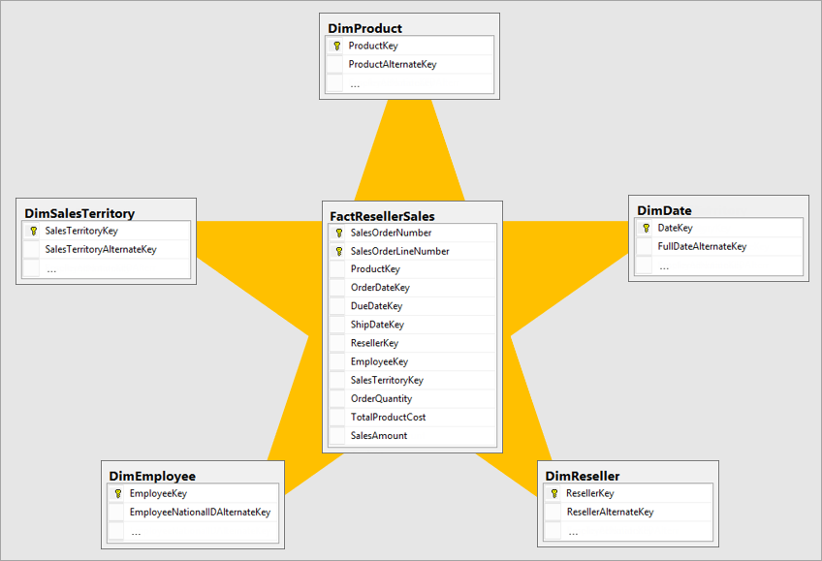
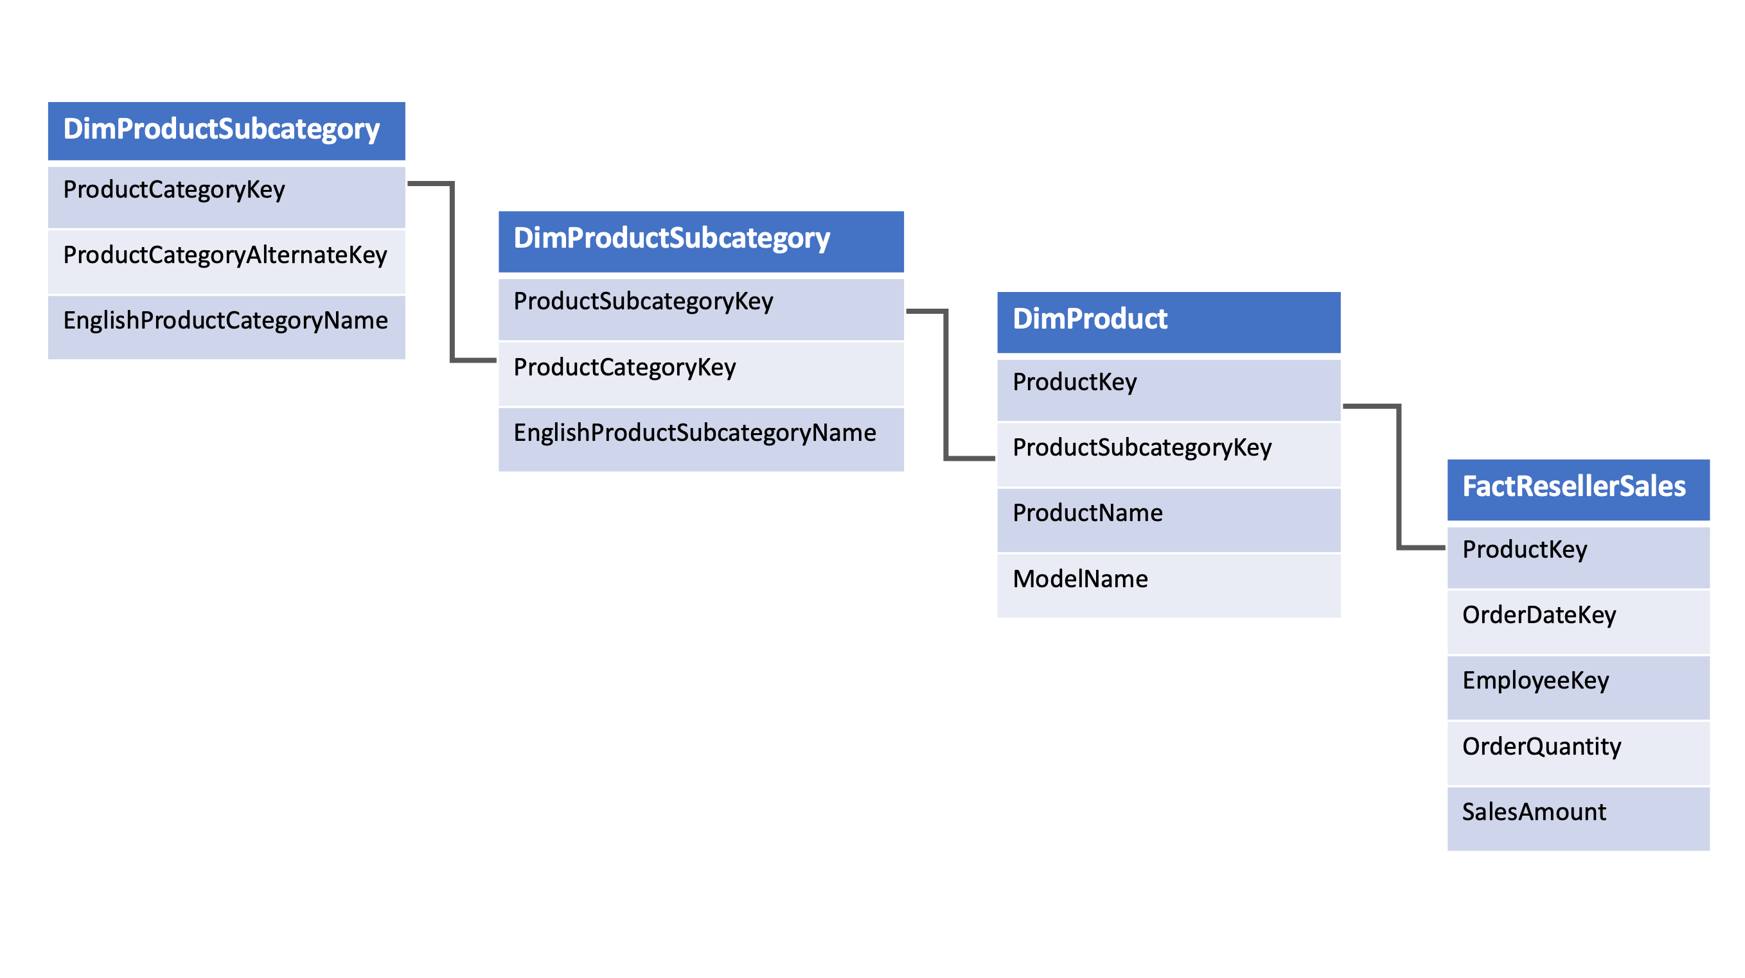
Design a multidimensional schema to optimize analytical workloads
Notes:
Talking points
(Click 1)
Dimension tables
Dimension tables describe business entities—the things you model. Entities can include products, people, places, and concepts including time itself. The most consistent table you'll find in a star schema is a date dimension table. A dimension table contains a key column (or columns) that acts as a unique identifier, and descriptive columns. Dimension tables contain attribute data that might change but usually changes infrequently.
Fact tables
Fact tables store observations or events, and can be sales orders, stock balances, exchange rates, temperatures, etc. A fact table contains dimension key columns that relate to dimension tables, and numeric measure columns. The dimension key columns determine the dimensionality of a fact table, while the dimension key values determine the granularity of a fact table. For example, you have a sales fact table with two dimension key columns: Date and ProductKey. This table has 2 dimensions, but since the values stored in the Date column are the first day of the month, the granularity is at the month-product level.
It is not uncommon to have multiple fact tables within a single data warehouse to answer a range of business questions.
(Click 2)
(Click 3)
Snowflake schema
The snowflake schema is a set of normalized tables for a single business entity. It aims to normalize the data to reduce the repetition in the data and therefore the space taken up by the data, leading to fewer IO requests making it quicker to retrieve the data in queries.
In reality, typical data warehouse solutions have a hybrid of the two schemas to fulfill analytical requirements.
Instructor notes and guidance.
This slide is a build slide
Click 1 – brings in the star schema graphic
Click 2 – the star schema graphic disappears
Click 3 – the snowflake schema graphic appears

Slide 24
Populate slowly changing dimensions in Azure Synapse Analytics pipelines
5

Slide 25
Slowly changing dimensions
A slowly changing dimension is one that appropriately manages the change of dimension members over time.
Applies when the values of a business entity change over time and not on a schedule.
In contrast, dimensions like a stock’s market price are considered rapidly changing.
Notes:
A slowly changing dimension (SCD) is one that appropriately manages the change of dimension members over time.
It applies when the values of a business entity change over time, and not on a set schedule.
A good example of an SCD is a customer dimension, specifically its contact detail columns like email address and phone number.
In contrast, some dimensions are considered to be rapidly changing when a dimension attribute changes often, like a stock's market price.
The common design approach in these instances is to store rapidly changing attribute values in a fact table measure.
However, for slowly changing dimensions the changing members should remain in the dimension table.
The design used for handling SCDs depends on the business requirements for the dimension table.

Slide 26
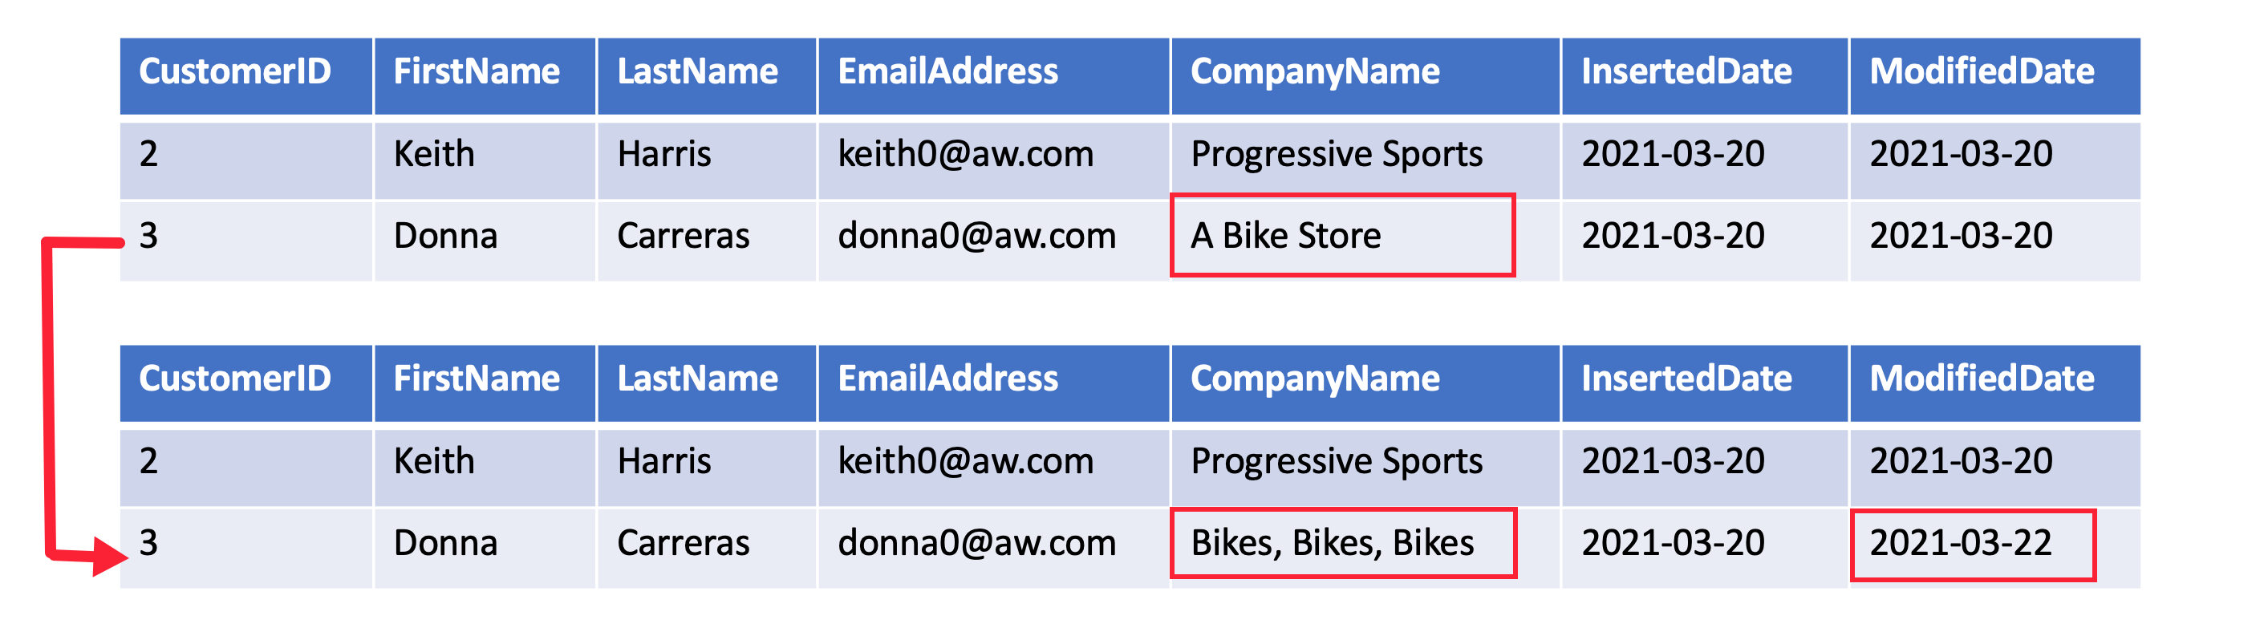
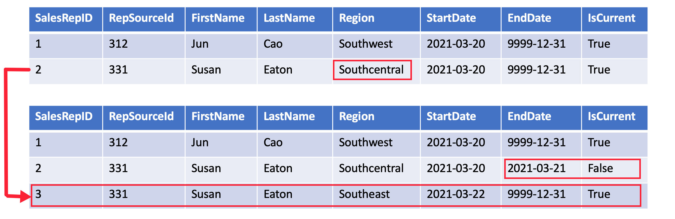
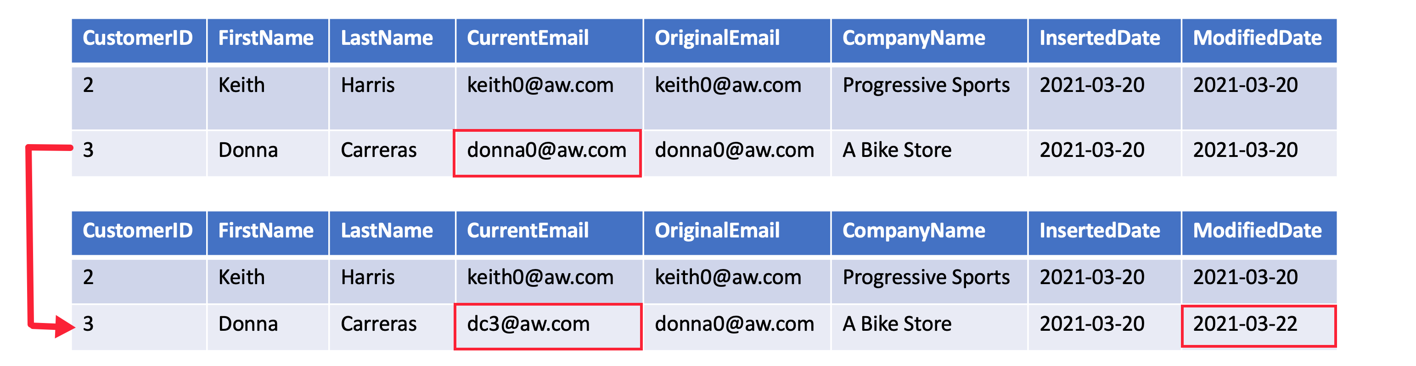
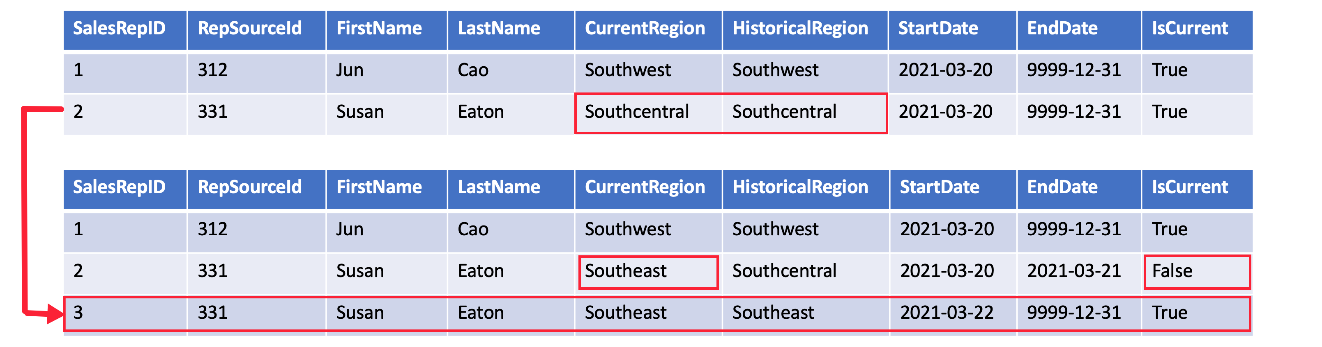
Populate slowly changing dimensions in Azure Synapse Analytics pipelines
SCD Type 1
SCD Type 2
SCD Type 3
SCD Type 6
Notes:
A Type 1 SCD always reflects the latest values, and when changes in source data are detected, the dimension table data is overwritten.
A **Type 2 SCD** supports versioning of dimension members. The dimension table must use a surrogate key to provide a unique reference to a version of the dimension member. It also includes columns that define the date range validity of the version (for example, `StartDate` and `EndDate`) and possibly a flag column (for example, `IsCurrent`) to easily filter by current dimension members.
A **Type 3 SCD** supports storing two versions of a dimension member as separate columns. The table includes a column for the current value of a member plus either the original or previous value of the member. So Type 3 uses additional columns to track one key instance of history, rather than storing additional rows to track each change like in a Type 2 SCD.
A **Type 6 SCD** combines Type 1, 2, and 3. When a change happens to a Type 2 member you create a new row with appropriate StartDate and EndDate. In Type 6 design you also store the current value in all versions of that entity so you can easily report on the current value or the historical value.
Instructor notes and guidance.
This slide is a build slide
Click 1 – brings in the SCD type 1 graphic
Click 2 – removes the SCD type 1 graphic
Click 3 – brings in the SCD type 2 graphic
Click 4 – removes the SCD type 2 graphic
Click 5 – brings in the SCD type 3 graphic
Click 6 – removes the SCD type 3 graphic
Click 7 – brings in the SCD type 6 graphic
Click 8 – removes the SCD type 6 graphic
Recommended reading for this slide
Populate slowly changing dimensions in Azure Synapse Analytics pipelines - Learn | Microsoft Docs

Slide 27
Like any good wrangler / tamer / explorer / investigator / builder / maintenance worker / janitor / mechanic, you need tools!
3
Notes:
Move to “Explore compute and storage options for data engineering workloads” presention
Talking Points:
Lets look at the security considerations

Slide 28

A data engineer’s toolbox and skillset
ETL tools
Data exploration & management tools (SSMS, Azure Data Studio, Storage Explorer, etc.)
Query languages such as SQL
Python
Spark/Hadoop
HDFS & data lakes
Visualization & BI tools

Slide 29

“Now we have a new problem… I have to set up and manage several tools and environments to do my job!”
- Internal monologue
Notes:
These problems are what set data engineers apart from DBAs, data analysts, and data scientists. As data engineers, we need to be proficient in many tools and technologies to build data pipelines, integrate systems, and meet the needs of many who rely on this valuable data.

Slide 30

Synapse Analytics to the rescue!

Slide 31
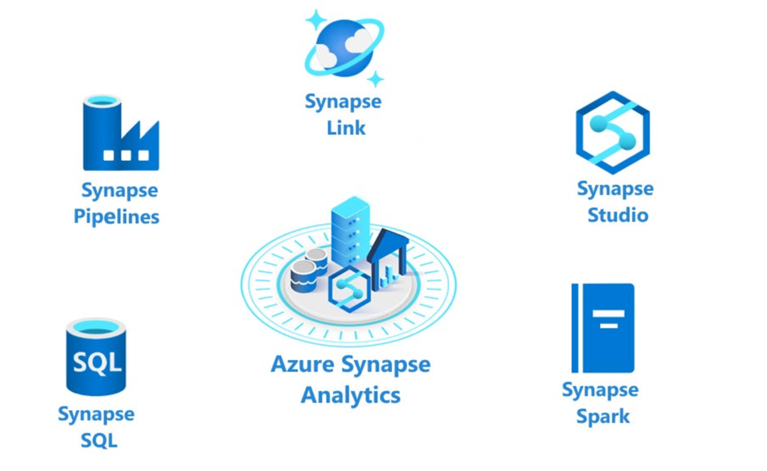
Synapse Analytics Components
Notes:
The following components are available in Azure Synapse Analytics:
- Analytics capabilities are offered through Synapse SQL through either dedicated SQL pools or serverless SQL pools.
- Apache Spark pool with full support for Scala, Python, SparkSQL, and C# with Synapse Spark
- Data Integration & Orchestration to integrate your data and operationalize all of your code development with Synapse Pipelines
- Perform operational analytics with near real-time hybrid transactional and analytical processing with Azure Synapse Link.
- Use Synapse Studio to access all of these capabilities through a single Web UI

Slide 32
I might have missed it, but… what are dedicated SQL pools again?
5
Notes:
Move to “Ingest and load data into the data warehouse” presentation

Slide 33
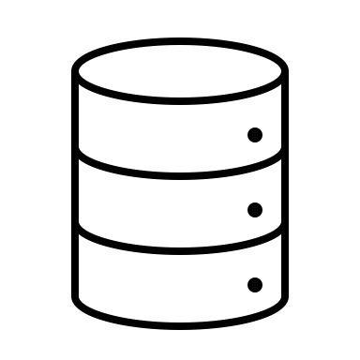
Azure Synapse dedicated SQL pools
Dedicated SQL Pools refers to the enterprise data warehousing feature available in Azure Synapse Analytics. Dedicated SQL Pools represent the dedicated compute resources required to process data loads and queries for relational big data workloads. The size of SQL pool is determined by Data Warehousing Units (DWU).
Notes:
Think of dedicated SQL pools as being the data warehouse part of Synapse. They represent the massively parallel processing (MPP) part of the equation and replace the functionality of the older Azure SQL Data Warehouse product.

Slide 34
I’ve heard of SQL Server, but what’s serverless SQL?
6
Notes:
Move to “Run interactive queries using Azure Synapse Analytics serverless SQL pools” presentation

Slide 35
Synapse serverless SQL pools
Logical data warehouse
Create objects (such as VIEWs and External Tables) that provide you with a SQL metadata layer over the data in the lake to create a logical data warehouse. Once these objects are created, any tool that can connect to serverless SQL pool will see these objects as regular SQL Server objects
Every Azure Synapse Analytics workspace comes with serverless SQL pool endpoints so you can start querying data in seconds to minutes in a data lake as soon as the workspace is created. There's no infrastructure to setup or clusters to maintain.
Data Exploration
Data transformation
Browse the data lake and get initial insights about the data. Using Azure Synapse Studio, you can explore the data both graphically and programmatically.
Serverless SQL pool enables you to execute transformation statements over the data in the lake and store the results back to the data lake in a specified file format.
Notes:
Every Azure Synapse Analytics workspace comes with a built in serverless SQL pool endpoint that you can be used to query files in a data lake.
Serverless SQL pool is serverless, hence there's no infrastructure to setup or clusters to maintain. A default endpoint for this service is provided within every Azure Synapse workspace, so you can start querying data as soon as the workspace is created. There is no charge for resources reserved, you are only being charged for the data processed by queries you run; so this model is a true pay-per-use model.
If you use Apache Spark for Azure Synapse in your data pipeline, for data preparation, cleansing or enrichment, you can query external Spark tables you've created in the process, directly from serverless SQL pool. Use Private Link to bring your serverless SQL pool endpoint into your managed workspace VNet.

Slide 36
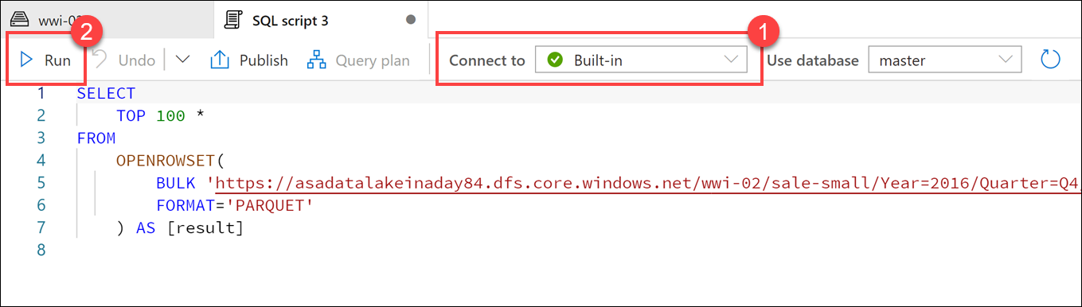
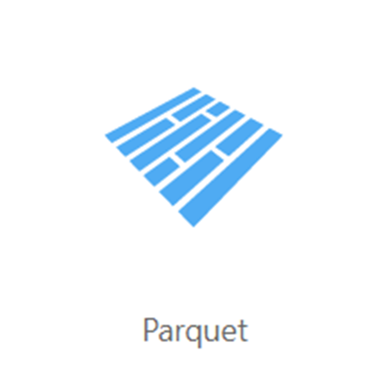
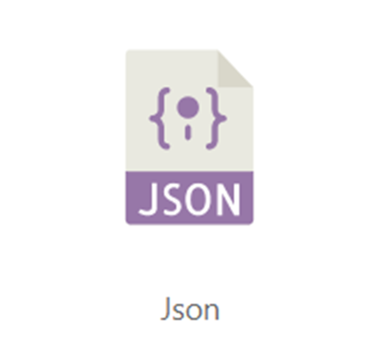
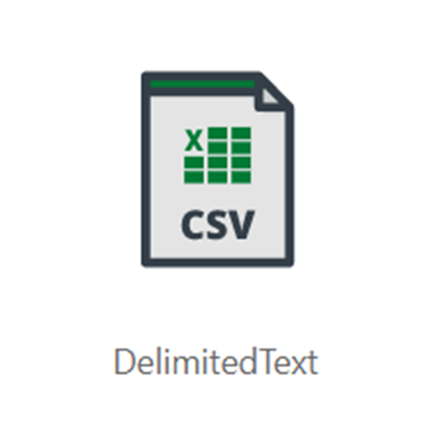
Query data in the lake using Azure Synapse serverless SQL pools
Notes:
Serverless SQL pools enable you to query data in your data lake. They offer a T-SQL query surface area that accommodates semi-structured and unstructured data queries. For querying, the following T-SQL aspects are supported:
- Full SELECT surface area, including a majority of SQL functions and operators.
- CREATE EXTERNAL TABLE AS SELECT (CETAS) creates an external table and then exports, in parallel, the results of a Transact-SQL SELECT statement to Azure Storage.
To support a smooth experience for in-place querying of data that's located in Azure Storage files, serverless SQL pool uses the OPENROWSET function with additional capabilities including:
- Query multiple files or folders
- Query PARQUET file format
- Query CSV and delimited text (field terminator, row terminator, escape char)
- Read a chosen subset of columns
- Use schema inference
- Use the filename function
- Use the filepath function
- Work with complex types and nested or repeated data structures

Slide 37
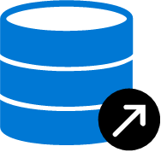



CREATE DATABASE [YourDatabaseName]
Database
Create metadata objects in Azure Synapse serverless SQL pools
CREATE DATABASE SCOPED CREDENTIAL [sqlondemand]
WITH IDENTITY='SHARED ACCESS SIGNATURE',
SECRET = 'sv=2018-03-28&ss=bf&srt=sco&sp=rl&'
Database
scoped credential
CREATE EXTERNAL DATA SOURCE SqlOnDemandDemo WITH (
LOCATION = 'https://sqlondemandstorage.blob.core.windows.net',
CREDENTIAL = sqlondemand );
External data source
CREATE EXTERNAL FILE FORMAT QuotedCsvWithHeaderFormat
WITH
( FORMAT_TYPE = DELIMITEDTEXT,
FORMAT_OPTIONS ( FIELD_TERMINATOR = ',', STRING_DELIMITER = '"', FIRST_ROW = 2 ) );
External file format
CREATE EXTERNAL TABLE populationExternalTable
( [country_name] VARCHAR (100) COLLATE Latin1_General_BIN2,
[year] smallint, [population] bigint )
WITH
( LOCATION = 'csv/population/population.csv’,
DATA_SOURCE = sqlondemanddemo,
FILE_FORMAT = QuotedCSVWithHeaderFormat );
External Table
Notes:
Metadata objects help you query data or optimize your existing data transformation pipeline through Azure Synapse serverless SQL pools. It also enables clients connecting to the serverless SQL pool to discover the objects to query the data in the lake. This essentially creates a semantic layer over which tools like Power BI can use to easily consume the data.
(Click) You should start of by creating a database, and then you can create the following objects to organise the data so that it can be accessed securely:
(Click) Database scoped credential
(Click) External data source
(Click) External file formats
(Click) External tables
(Click) Views
Metadata objects can help you simplify understanding the data that is held in the files of a data lake by enabling you to define a semantic layer on top of the files. This initial step can also simplify the transformation that you may use against the data as it can be presented as tables in the serverless SQL pool.
The ability to create metadata objects within a serverless SQL pools in Azure Synapse Analytics provides some opportunities for customers to use it as a proof-of-concept layer for any potential enterprise data warehouses that they may consider creating. It is important to note; however, that it is better to transition the proof of concept to a dedicated SQL pools where the data and resources are persisted should the proof-of-concept be a success, and the decision is made to make the enterprise data warehouse more permanent.

Slide 38
Comparing dedicated SQL Pools with serverless SQL pools in Azure Synapse Analytics
Dedicated SQL pools
Serverless SQL pools
Used for Data Warehouse operations
Provides predictable performance and costs
Reserves processing power for data stored in SQL tables
Used for data preparation or ad-hoc queries against unstructured data.
Provides an always available SQL endpoint for unplanned workloads
Enables interactive querying
Notes:
Synapse SQL offers both serverless and dedicated resource models, offering consumption and billing options to fit your needs. For predictable performance and cost, provision pools to reserve processing power for data stored in SQL tables. For unplanned or bursty workloads, use the serverless, always-available SQL endpoint.

Slide 39

So, what is a data lake and why is it such a big deal?
Notes:
Move to “Explore compute and storage options for data engineering workloads pres
A data lake is a storage repository that inexpensively stores a vast amount of raw data, both current and historical, in native formats such as XML, JSON, CSV, and Parquet. It may contain data from operational relational databases with live transactional data.
When you deal with lots of data coming in at different speeds from different sources in different formats, you need a place to land it all. Data lakes are very cost-effective, allowing us to store data in its various states and forms, for very long periods of time. Like forever.

Slide 40
Loading data into the data lake: ingest and prepare
Gather data
Examine data
Store in native format
Standardize data
Notes:
Data ingestion, just as it sounds, is the process of gathering data of any format from various systems, whether they be on-premises, in the cloud, an API, or any other source, and copying it into a centralized location.
Data discovery, exploration & preparation:
Part of gathering data is integrating with our data sources as a starting point for our data pipeline.
Before we can work with the ingested data, we need to examine the data, and set up some standards for the data we plan to work with.
Data coming from different sources needs to be put into a common format.
Data types and column names need to be standardized.

Slide 41
A deeper dive into the tools and skills
7
Notes:
Move to “Explore compute and storage options for data engineering workloads” presentation

Slide 42






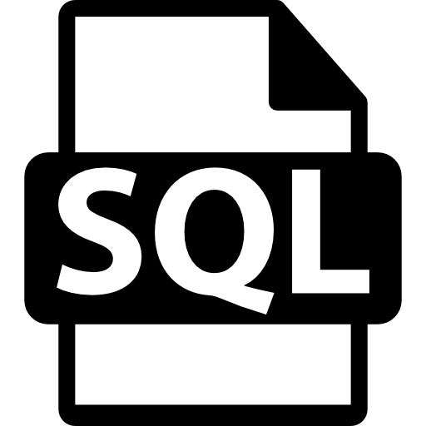
ETL on Azure
You’ve got to move it move it!
Azure Data Factory
SQL Server Integration Services (SSIS)
HDInsight with Hive
Oozie on HDInsight
Azure Databricks
SQL with PolyBase or COPY activity
Synapse Analytics pipelines
Notes:
Azure Data Factory – 95+ connectors, visual design with low code, PaaS option
SSIS – ETL tool traditionally used with on-premises SQL Server. Most SSIS packages can be hosted in Azure Data Factory
HDInsight with Hive – Data warehouse system for Hadoop. It enables data summarization, querying, and analysis. Hive queries are written in HiveQL, similar to SQL
Oozie on HDInsight – Workflow and coordination system that manages Hadoop jobs. Oozie is integrated with the Hadoop stack and supports MapReduce, Pig, Hive, and Sqoop. It can schedule jobs specific to a system, like Java programs or shell scripts
Azure Databricks – Powerful managed Spark PaaS service. You can create schedule jobs, call Databricks notebooks from external services like ADF or Synapse, and programmatically execute notebooks or modules from a number of solutions.
SQL with PolyBase or COPY activity – Access files stored in your data lake and load them into your data warehouse by using PolyBase or COPY activities for efficient data movement. You can do this from SSMS, Azure Data Studio, or data pipeline and integration tools like ADF.

Slide 43
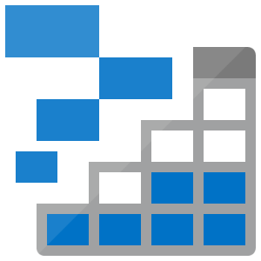
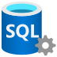

Data exploration, management, and transformation
This is a big (data) lake. Should have brought a bigger boat!
Azure Storage Explorer
Azure Data Studio / SSMS
HDInsight
Azure Databricks
Synapse Analytics
Notes:
Azure Storage Explorer – Desktop application makes it fast and easy to manage Azure storage accounts and upload multiple files through a visual interface.
Azure Data Studio / SSMS – Desktop applications that allow you to manage, manipulate, and explore various types of databases. Azure Data Studio adds extensions to do things like work with notebooks. You can also explore the data lake with SQL when you use PolyBase.
Azure Databricks –
Synapse Analytics – Synapse Spark and serverless SQL pools enable you to efficiently explore, manage, transform, and load your data.

Slide 44
Let’s talk about loading data into the dedicated SQL pool
8
Notes:
Move to “Ingest and load data into the data warehouse” presentation

Slide 45
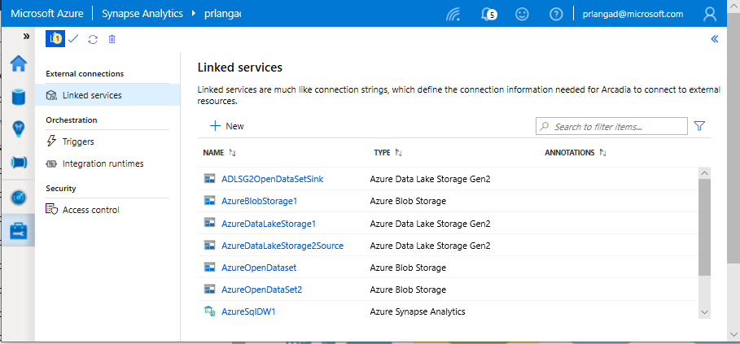
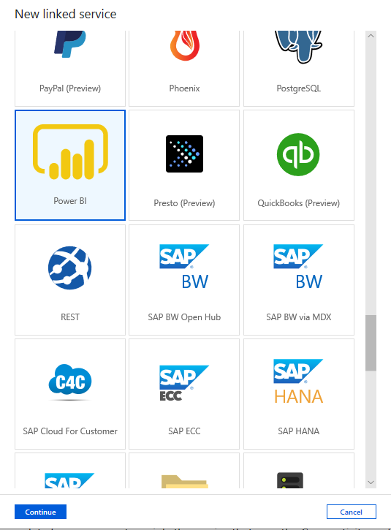
Linked services
Overview
Linked services define the connection information needed to connect to external resources.
Benefits
Offers pre-built 95+ connectors
Easy cross-platform data migration
Represents data store or compute resources

Slide 46
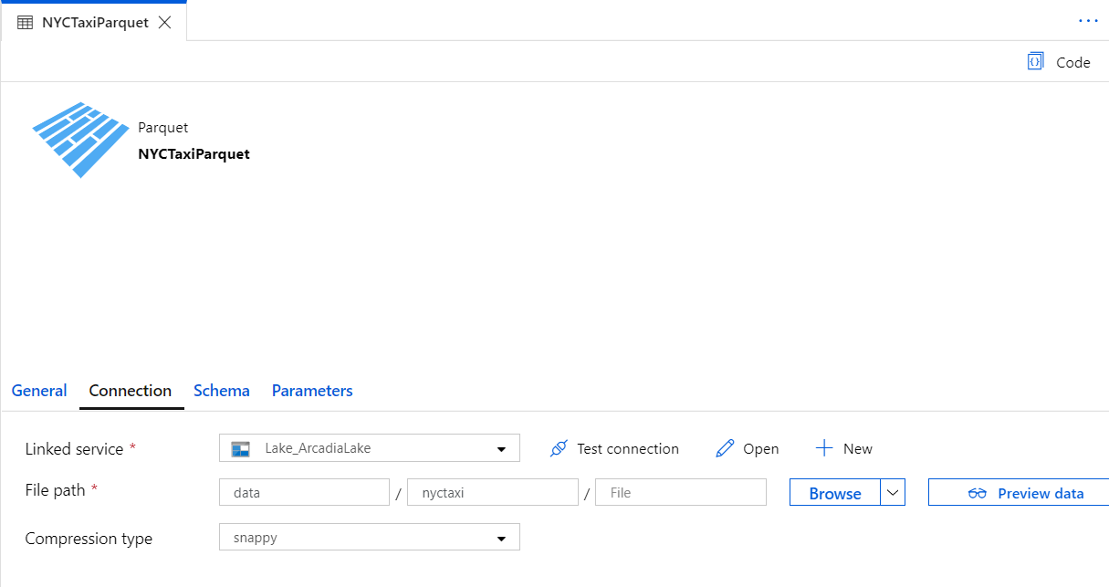
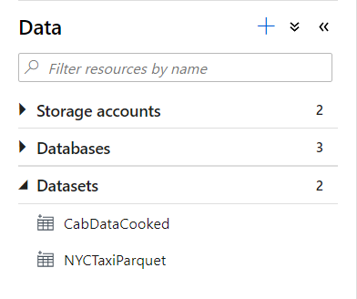
Datasets
Orchestration datasets describe data that is persisted.
Once a dataset is defined, it can be used in pipelines and sources of data or as sinks of data.

Slide 47
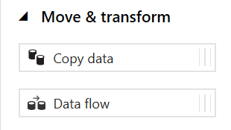
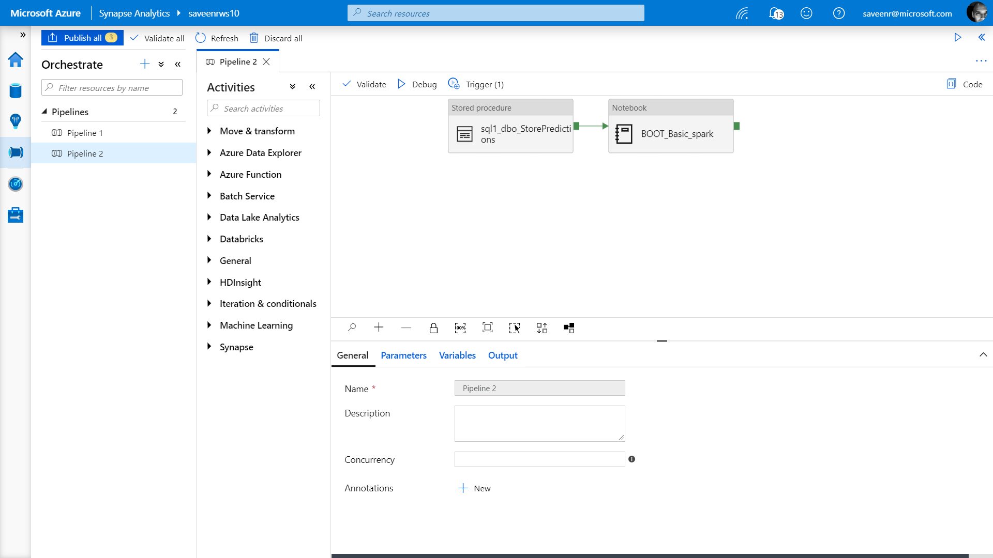
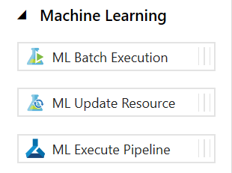
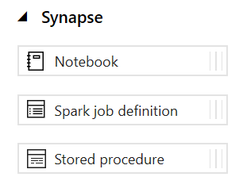
Pipelines
Notes:
Create pipelines to ingest, transform and load data with 95+ inbuilt connectors.
Pipelines offer a wide range of activities that they can perform.
They provide ability to load data from a storage account or other connectors to the desired linked service.
You can load data by manual execution of the pipeline or by orchestration.
Benefits
Pipelines support common loading patterns and provide fully parallel loading into the data lake or SQL tables.
All of this is done through a graphical development experience.

Slide 48
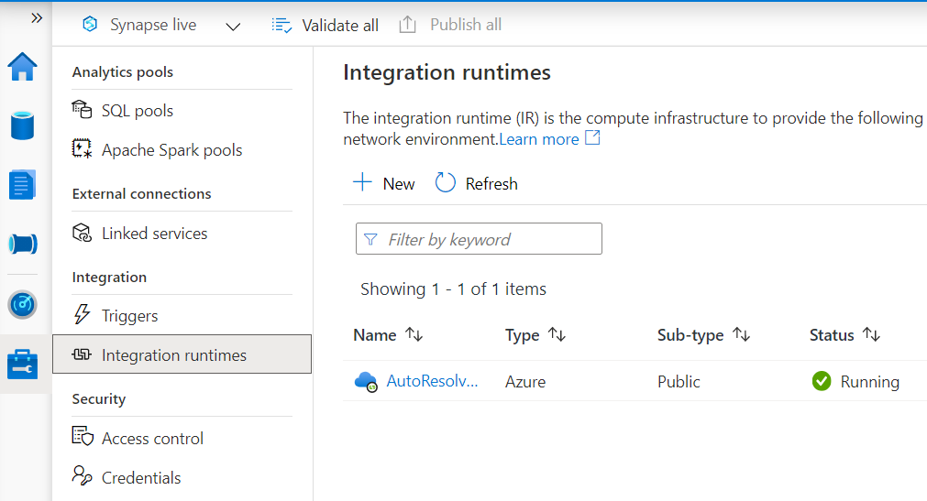
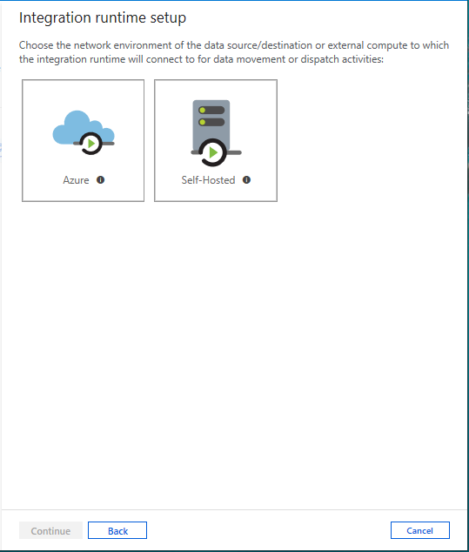
Integration runtimes
Overview
Integration runtimes are the compute infrastructure used by Pipelines to provide the data integration capabilities across different network environments. An integration runtime provides the bridge between the activity and linked services.
Benefits
Offers Azure Integration Runtime or Self-Hosted Integration Runtime
Azure Integration Runtime – provides fully managed, serverless compute in Azure
Self-Hosted Integration Runtime – use compute resources in on-premises machine or a VM inside private network
Notes:
Need to explain and why needed
Check with Gaurav

Slide 49
PolyBase vs COPY
PolyBase
COPY
Relaxed permission
No row width limit
Supports delimiters in text
Supports custom column and row delimiters
GA, stable
Needs CONTROL permission
Enables querying via external tables
Challenges:
Row width (1 MB)
Delimiters in text
Fixed line delimiter
Code complexity
Notes:
To use PolyBase, the user that loads data into Azure Synapse Analytics must have "CONTROL" permission on the target database. One way to achieve that is to add the user as a member of the db_owner role
PolyBase loads are limited to rows smaller than 1 MB. It cannot be used to load to VARCHR(MAX), NVARCHAR(MAX), or VARBINARY(MAX).

Slide 50
Notebooks aren’t just for doodling during class
9
Notes:
Move to “Data exploration and transformation in Azure Databricks” presentation

Slide 51
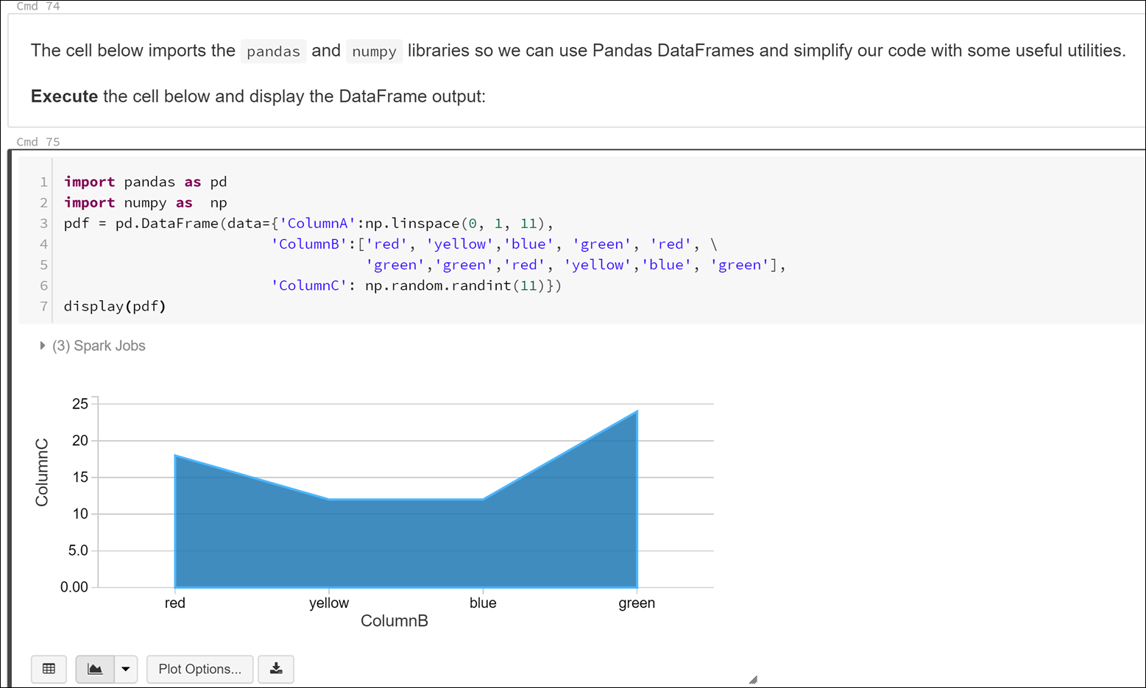
The notebook paradigm
Notebooks are self-documenting and easily shared
They contain a combination of runnable code, output, formatted text, and visualizations
Notebooks are the de facto standard for data scientists and engineers. They can call other notebooks or external libraries as needed

Slide 52



What is Apache Spark?
A unified processing engine to analyze big data with SQL, ML, graph processing, & real-time streaming
SQL / DataFrames
Machine Learning
Graph
Streaming
Notes:
The DataFrames API provides an abstraction above Resilient Distributed Datasets (RDDs) while simultaneously improving performance 5-20x over traditional RDDs with its Catalyst Optimizer.
Spark ML provides high quality and finely tuned machine learning algorithms for processing big data.
The Graph processing API gives us an easily approachable API for modeling pairwise relationships between people, objects, or nodes in a network.
The Streaming APIs give us End-to-End Fault Tolerance, with Exactly-Once semantics, and the possibility for sub-millisecond latency.

Slide 53
Apache Spark
One framework to rule them all.
Spark SQL
Interactive Queries
Spark MLlib
Machine Learning
Spark
Structured Streaming
Stream processing
GraphX
Graph Computation
Spark Unifies:
Batch Processing
Interactive SQL
Real-time processing
Machine Learning
Deep Learning
Graph Processing
Spark Core Engine
Yarn
Mesos
Standalone Scheduler
Spark runs batch and streaming workloads 100x faster than Hadoop
Notes:
Understanding data through data exploration is one of the core challenges faced today by data engineers and data scientists as well. Depending on the underlying structure of the data as well as the specific requirements of the exploration process, different data processing engines will offer varying degrees of performance, complexity, and flexibility.
In Azure Synapse Analytics, you can use either SQL, Apache Spark for Synapse, or both. Which service you use mostly depends on your personal preference and expertise. When conducting data engineering tasks, both options can be equally valid in many cases. However, there are certain situations where harnessing the power of Apache Spark can help you overcome problems with the source data. This is because in a Synapse Notebook, you can import from a large number of free libraries that add functionality to your environment when working with data. There are other situations where it is much more convenient and faster using serverless SQL pool to explore the data, or to expose data in the data lake through a SQL view that can be accessed from external tools, like Power BI.
Spark SQL
Unified data access: Query structured data sets with SQL or DataFrame APIs
Fast, familiar query language across all your enterprise data
Use BI tools to connect and query via JDBC or ODBC drivers
MLlib & SparkML
Predictive and prescriptive analytics
Machine learning algorithms for:
Clustering
Classification
Regression
etc.
Smart application design from pre-built, out-of-the-box statistical and algorithmic models
Spark Streaming
Micro-batch event processing for near-real time analytics
e.g. Internet of Things (IoT) devices, Twitter feeds, Kafka (event hub), etc.
Spark’s engine drives some action or outputs data in batches to various data stores
GraphX
Represent and analyze systems represented by graph nodes
Trace interconnections between graph nodes
Applicable to use cases in transportation, telecommunications, road networks, modeling personal relationships, social media, etc.

Slide 54






What are my options in Azure?
Azure Databricks
HDInsight Spark
Spark on VMs
AKS
Azure Synapse
Cosmos DB
SQL 2019 BDC

Slide 55


Slide 56

Ingest File Data Sources
Look out for these file format challenges…
Invalid file format
Multiple row types
Ragged columns
Row size > 1Mb
Datetime format/s (e.g., use of nanosecond date time)
NULL value literal/s
Free form text
Parquet partitions
XML data
Use of non-standard line delimiters (e.g., CR)
…and try these Solutions
Use Spark to pre-process and fix data errors
Flatten and parse XML in Spark
Use COPY to ingest complex CSV instead of PolyBase

Slide 57

Synapse integrates ML and Visualization into the workspace
Azure Machine Learning
Power BI

Slide 58



Official DP-203 labs with environment setup
https://aka.solliance.net/dp203
Conference workshop with labs and presentations
https://aka.solliance.net/azure-de-workshop
Solliance Training
https://aka.solliance.net/training

Slide 59
Register your lab environment
Navigate to https://portal.cloudlabs.ai/
Sign in with your Work or School account, Microsoft Account, LinkedIn, or Google
Navigate to the Redeem Voucher section in CloudLabs portal
Enter Voucher Code
Click on Redeem option
Once voucher is redeemed, navigate to ‘Courses’ tab under the ‘My Learning’ section and start learning by clicking to Get Started/ Start option

